Slide 1
MATLAB
GROUP 8
ODES AND ITERATION METHODS

Slide 2
ITERATION METHODS
Secant method
Newton Raphson method
Euler method
Improved Euler method
Bisection method
Runge – kutta

Slide 3
WHAT THE CODE DOES
• Models projectile motion height function.
• Finds the impact time (non-trivial root) using:
Bisection
False Position
Newton-Raphson
Secant

Slide 4
• Compares against the exact analytical solution.
• Plots:
Function with roots marked
Bar chart of runtimes
• Displays error values and computation times in the command window

Slide 5
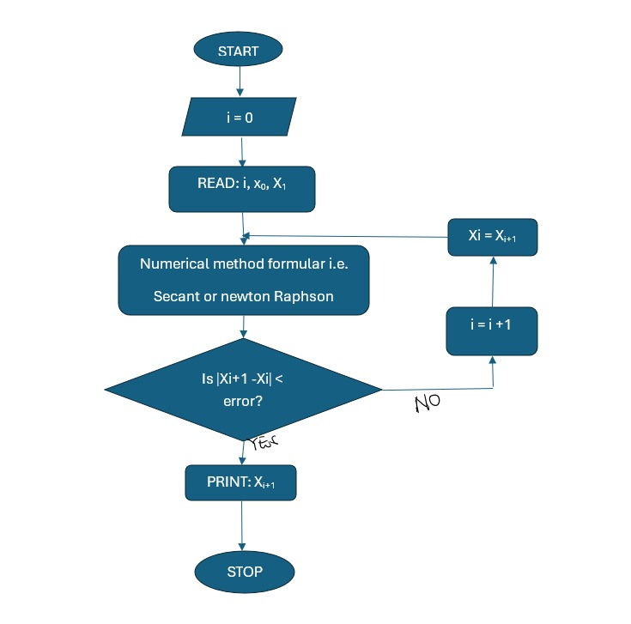
FLOW CHART

Slide 6
Real-Life Example Problem:
Projectile Motion A ball is thrown upward with velocity 𝑣0=20 m/S. Its height is:

Slide 7
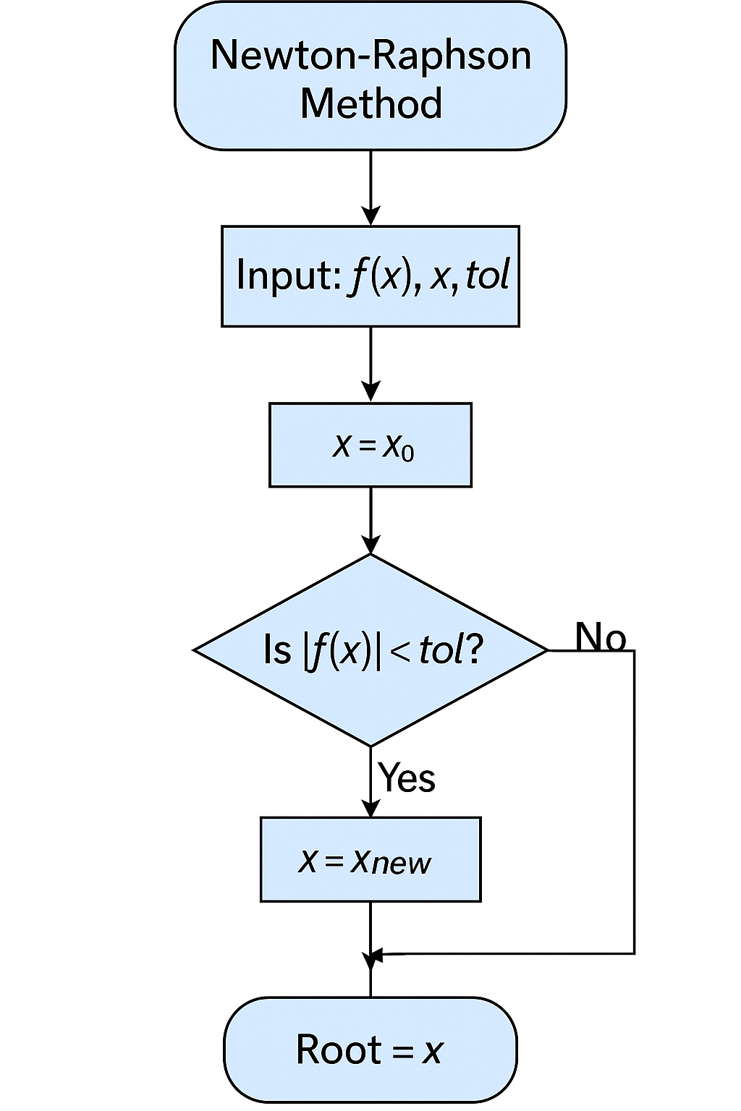
FLOW CHART OF NRM

Slide 8
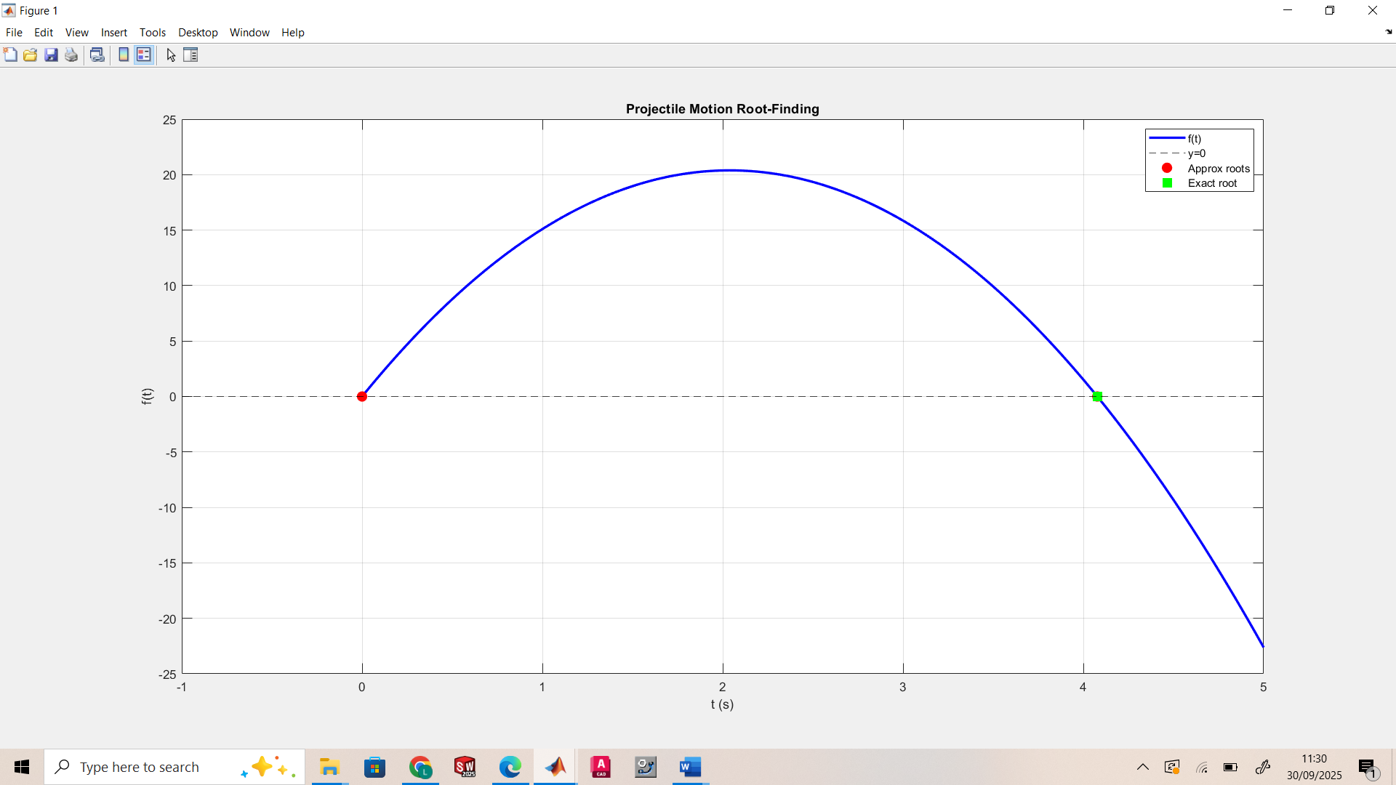

Slide 9
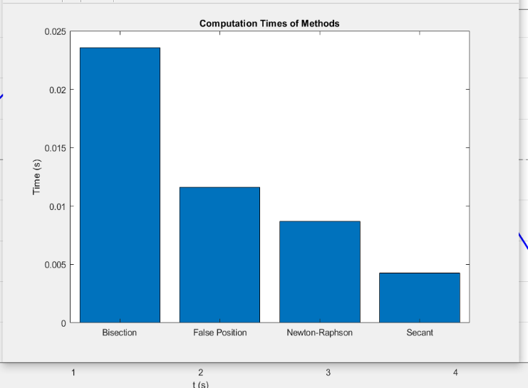
COMPARISON OF THE METHODS

Slide 10
ODES
We will solve with:
Euler’s Method
Improved Euler (Heun’s Method)
Runge-Kutta 4 (RK4)
(Optional) Adams-Bashforth or ode45 (MATLAB inbuilt)

Slide 11
Pseudocode (Euler’s Method)
Algorithm Euler(f, t0, y0, h, N)
1. Set t = t0, y = y0
2. For i=1:N
y(i+1) = y(i) + h * f(t(i), y(i))
t(i+1) = t(i) + h
3. Return( t, y)

Slide 12
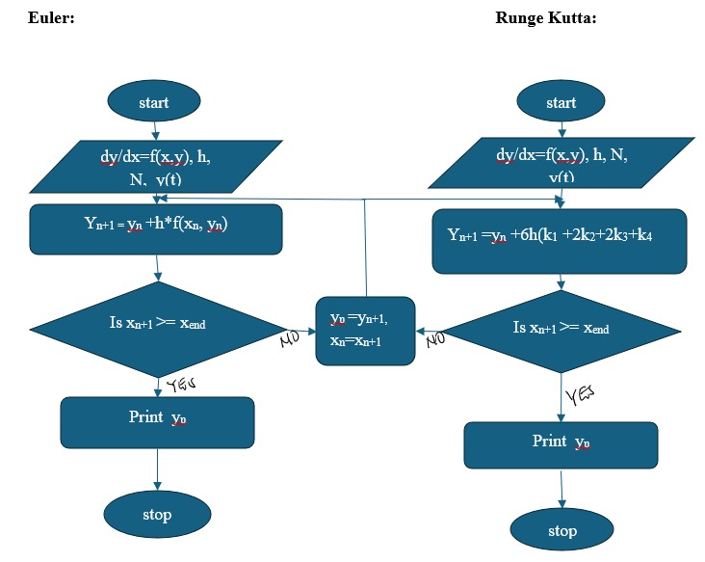
FLOW CHART

Slide 13
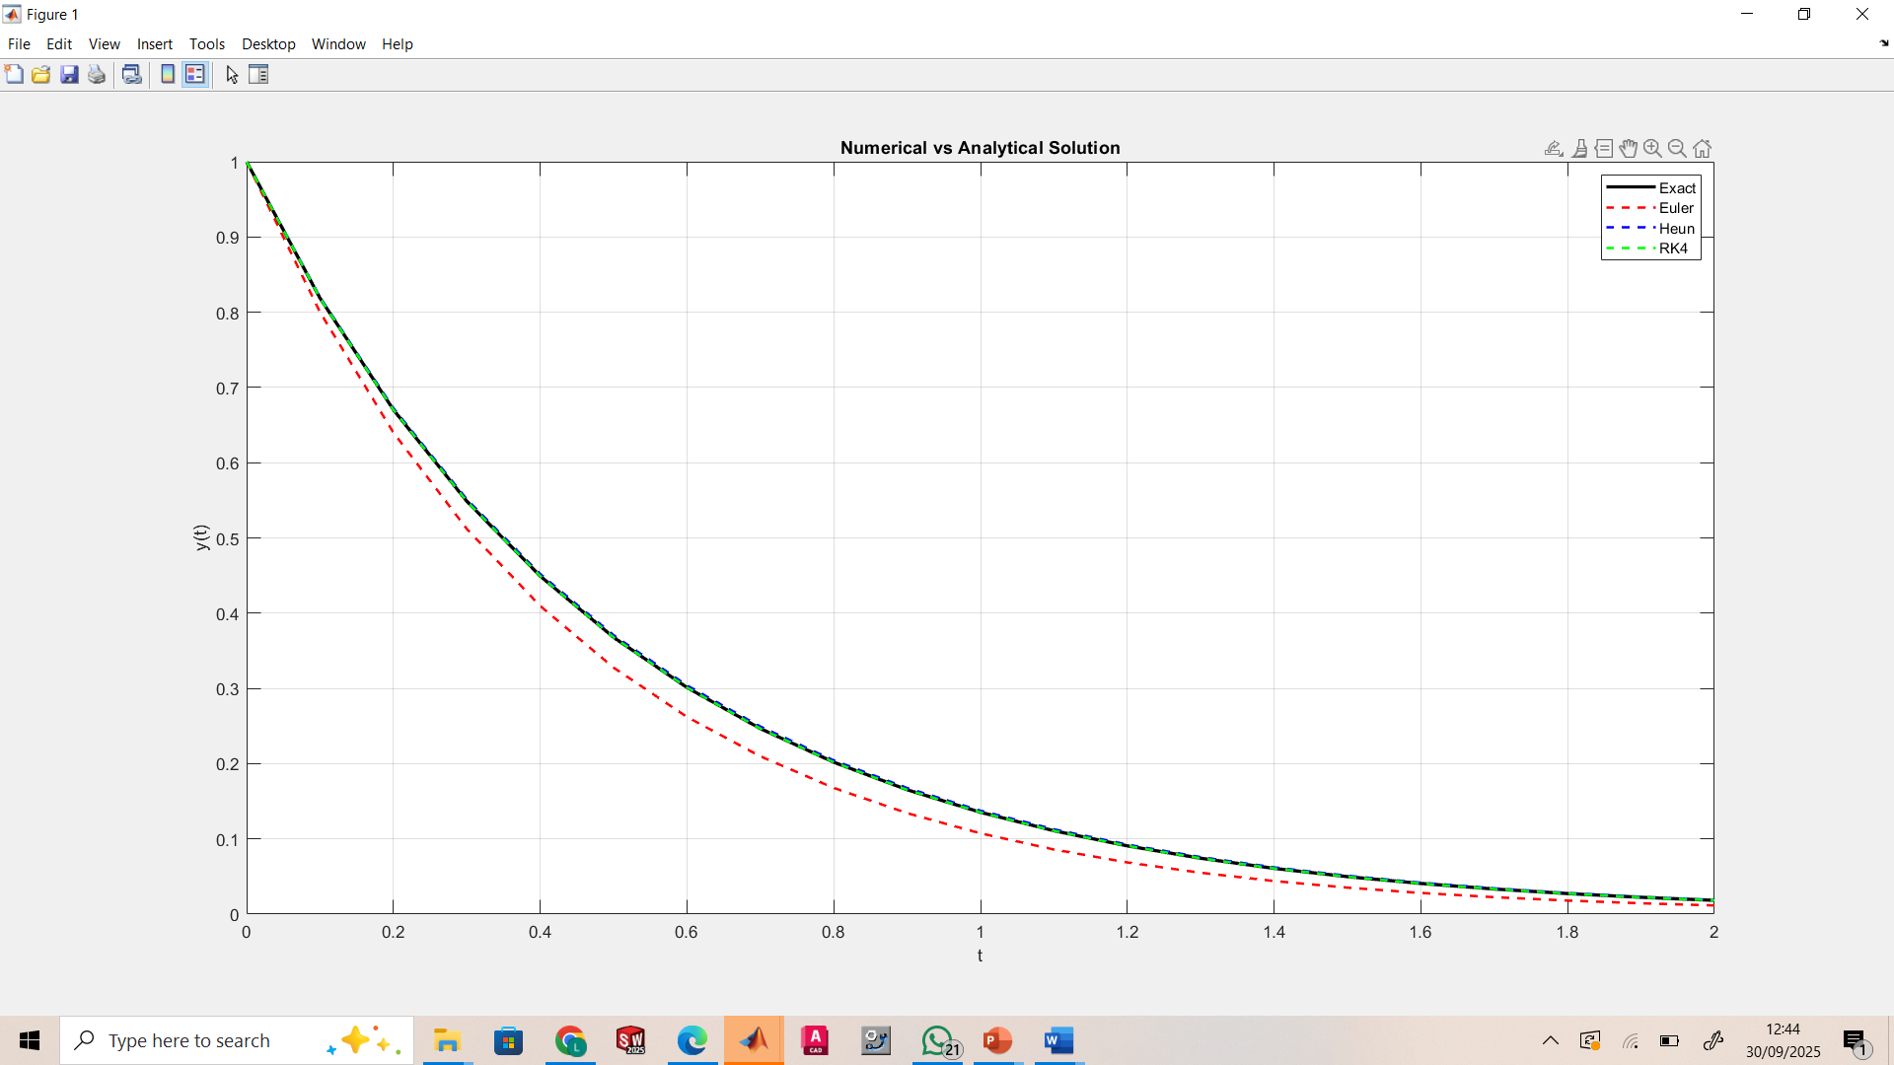
GRAPHS SHOWING VARIOUS COMPUTATION METHODS

Slide 14
conclusion
While the secant method can be faster than other methods in certain scenarios, its important to note that its performance can depend on the choice of the initial guesses and the nature of the function being analysed. Each method has its strengths and weakness, making them suitable for different types of problems.

